Slide 1
Autoencoders POC Peter Chen Georgia Tech CSE678 Fall 2019

Slide 2
Anomaly detection for rare events
Problem
Detect when a system is deviating from nominal behavior and is at risk of failure using sensor data
Ex. Aircraft engine stall, fire, mechanical imbalance, vibration failure
Challenges
Lack of failure data - extreme class imbalance
Curse of dimensionality – lots of sensors
Traditional techniques may not be effective – supervised learning, classification, thresholding, rule based
Potential Solution
Unsupervised learning using autoencoders – learn to predict nominal behavior accurately and assess reconstruction error to determine anomalies

Slide 3
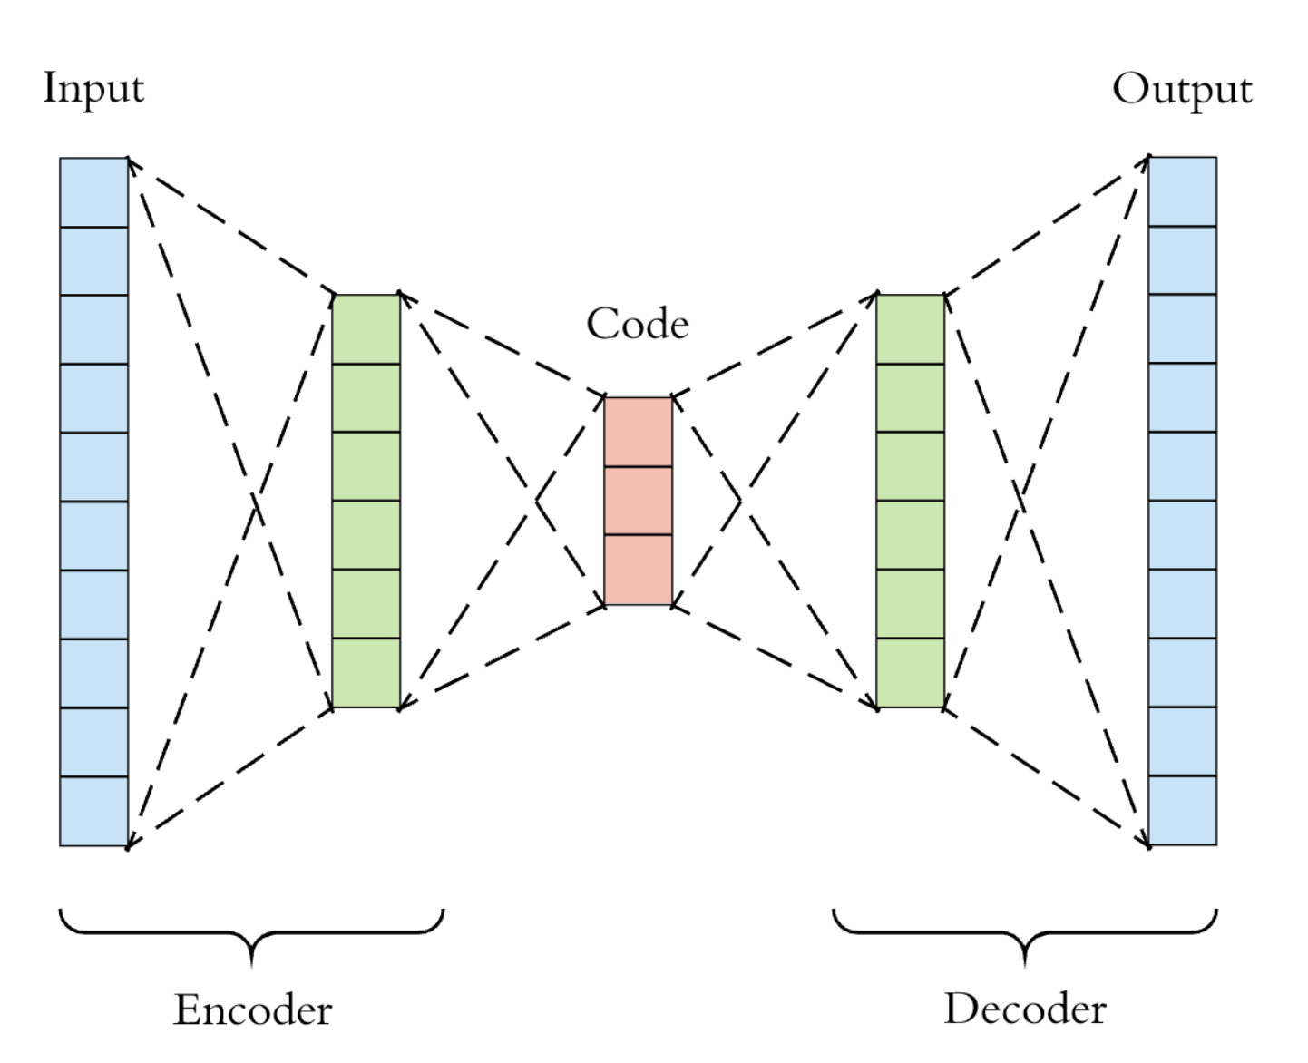
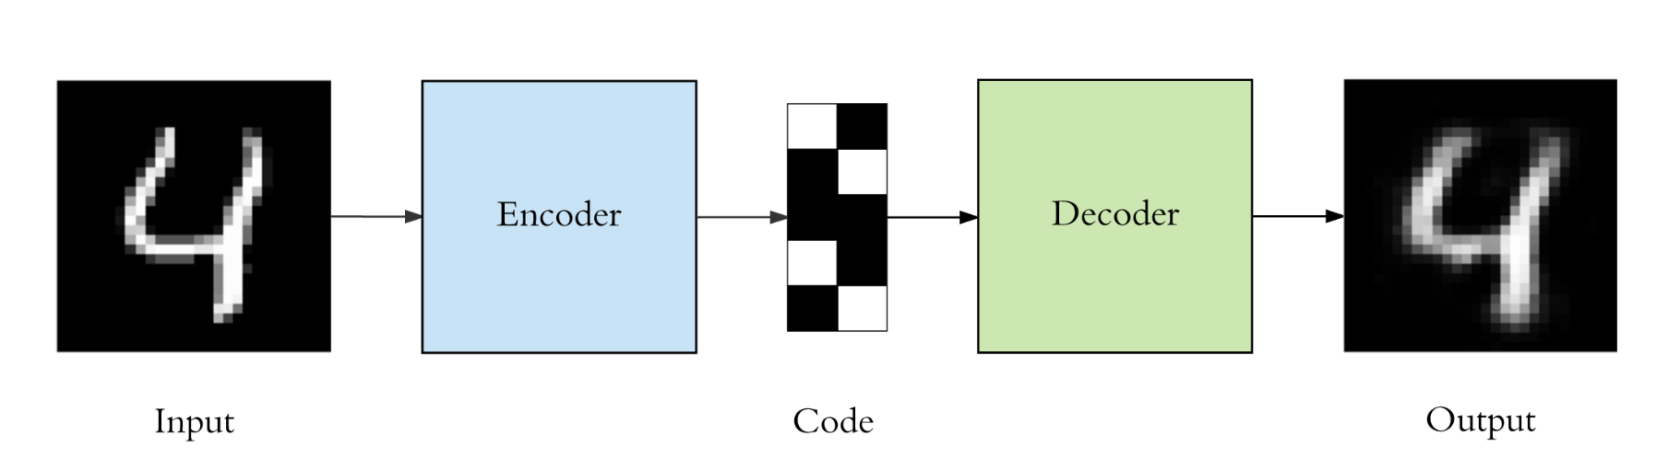
Neural Network Autoencoders
Autoencoder structure
Un supervised learning approach
Symmetric neural network where inputs = outputs
Utilize a bottleneck layer to compress the data by reducing dimensionality
Learn a simpler representation of the data
Similar to Principal Component Analysis (PCA) except that autoencoders are non-linear
Common use case - anomaly detection, image processing, information retrieval
bottleneck
Example Use Case
Notes:
T-sne – clustering

Slide 4
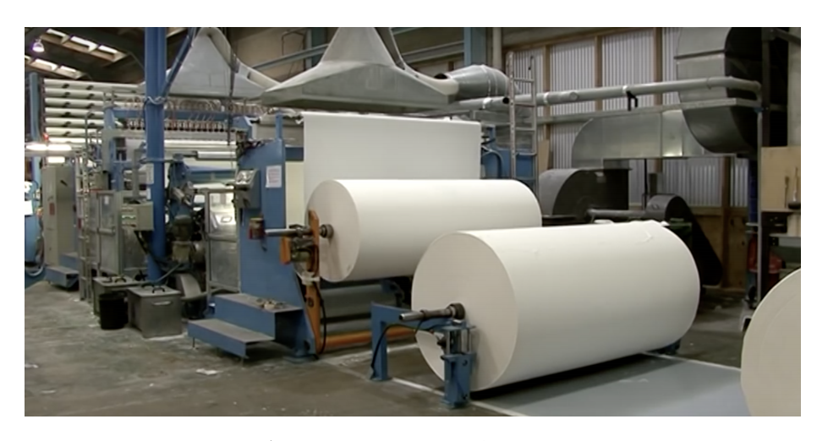
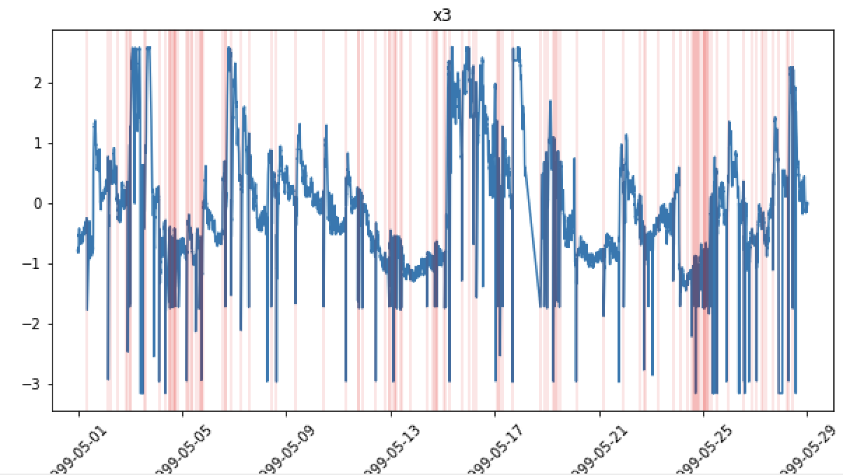
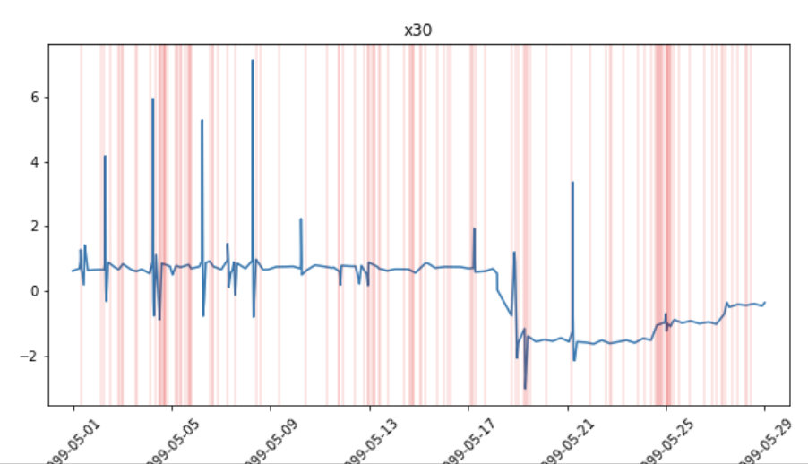
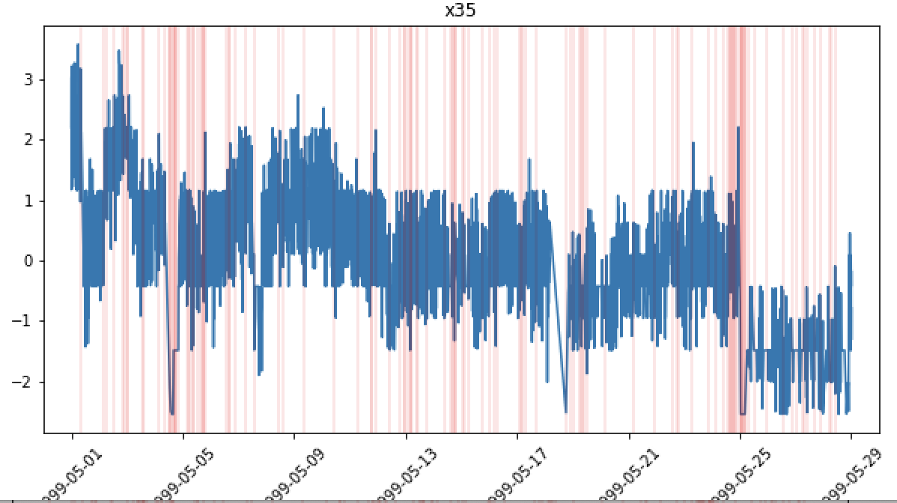
Dataset #1: Time series of Paper Mill Sensors
https://arxiv.org/pdf/1809.10717.pdf
Time series dataset of paper mill with 60 sensor parameters and 1 binary variable indicating failure and non-failures
Failures represent when the paper breaks, breaks can take over 1 hour to resolve
124 Failures are spread out throughout time dimension
~18K records over 1 month of usage (sampled every 2 minutes)
Large class imbalance – 124 failure vs 18,274 non-failure points (failures in red below)
In the paper – XGBoost supervised model had F1 score of .11

Slide 5

Data Preprocessing – Autoencoder
CSV file
Drop categorical variables
Binary target variable padding
Standard scaler
Train/test split
Keep 59/61 variables
Backfill 20 timesteps prior to failure as y = 1
Use 80% of non-failures to train

Slide 6
Autoencoder
Anomaly Detection
Train Model only on nominal data
Make Prediction on new data
Calculate reconstruction error for each sensor
Average errors and apply absolute value
Classify anomaly based on threshold of average error
- Set threshold based on training data
Input – 59 sensors (nominal)
Dense layer
(32 units)
Dense layer
(16 units)
bottleneck
Dense layer
(32 units)
Linear activation
Output – 59 sensors (nominal)
Batch = 12
Epochs = 150
Loss = mse
Notes:
Bayesian neural net

Slide 7
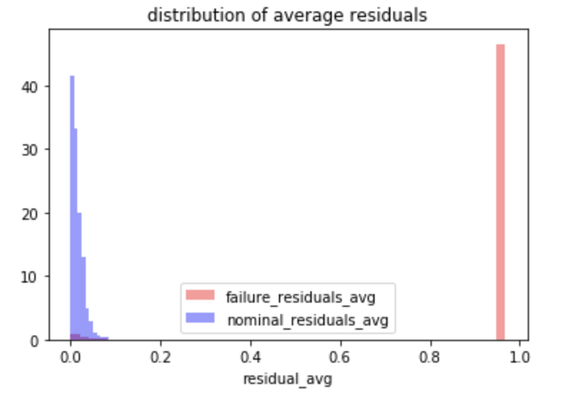
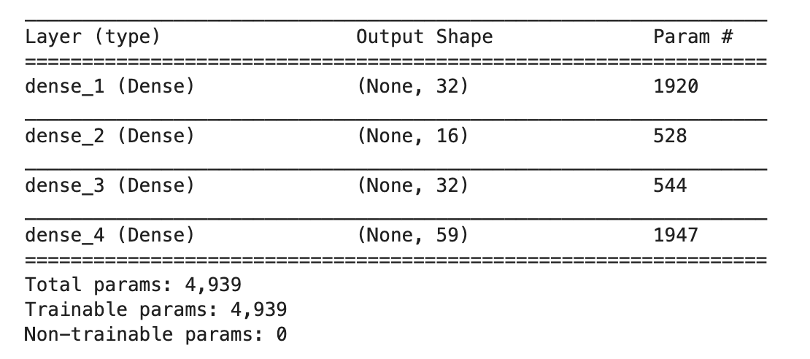
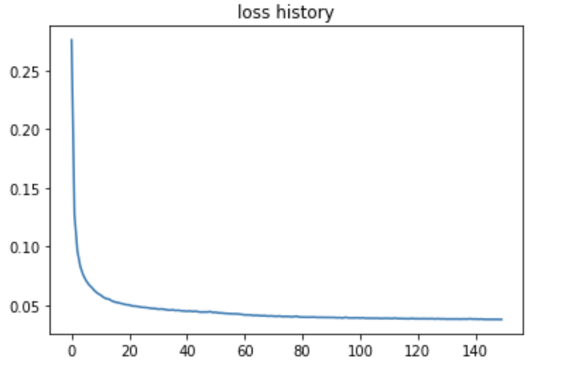
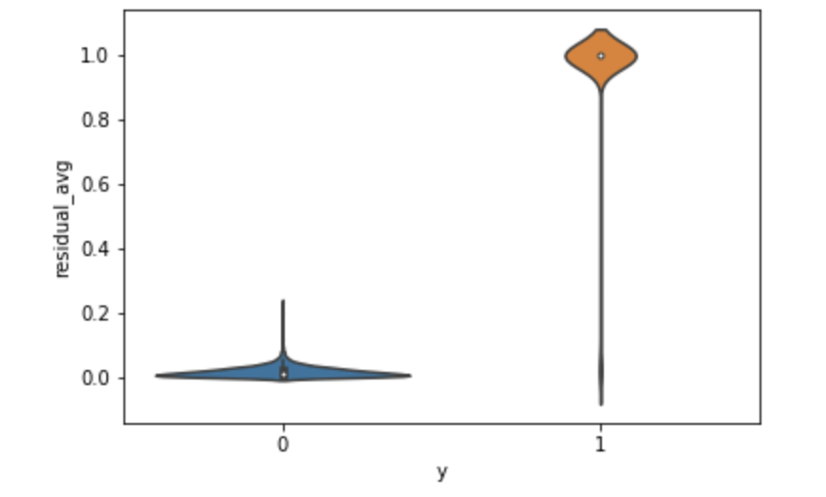
Preliminary Results
Test Set Metrics
nominal
failure
Autoencoder weights
Loss Curve
failure
nominal
Training time = 3 minutes on laptop

Slide 8
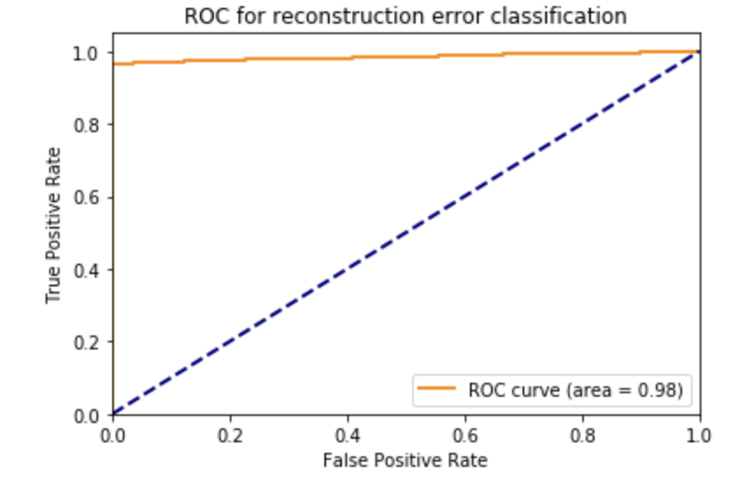
Threshold Evaluation
3σ
5σ
max
Test set has ~1600 nominal and ~2200 failure points
Use nominal errors to set threshold for failure/non-failure classification
 | XGBoost (Paper) | 3σ threshold | 5σ threshold | Max nominal
Precision | NA | .988 | .998 | 1.000
Recall | NA | .967 | .964 | .959
F1 Score | .11 | .977 | .981 | .979

Slide 9
Binary Pad Length Evaluation
Use 3 sigma threshold for classification
 | 10 padding | 20 padding | 30 padding
Precision
Recall
F1 Score

Slide 10
Binary Pad Length Plots

Slide 11
Next Steps
Evaluate results to understand error distribution
Compare different threshold methods
Test different topologies
Find more datasets
Determine way to benchmark autoencoders to other models
Apply to UTC use case

